Slide 1
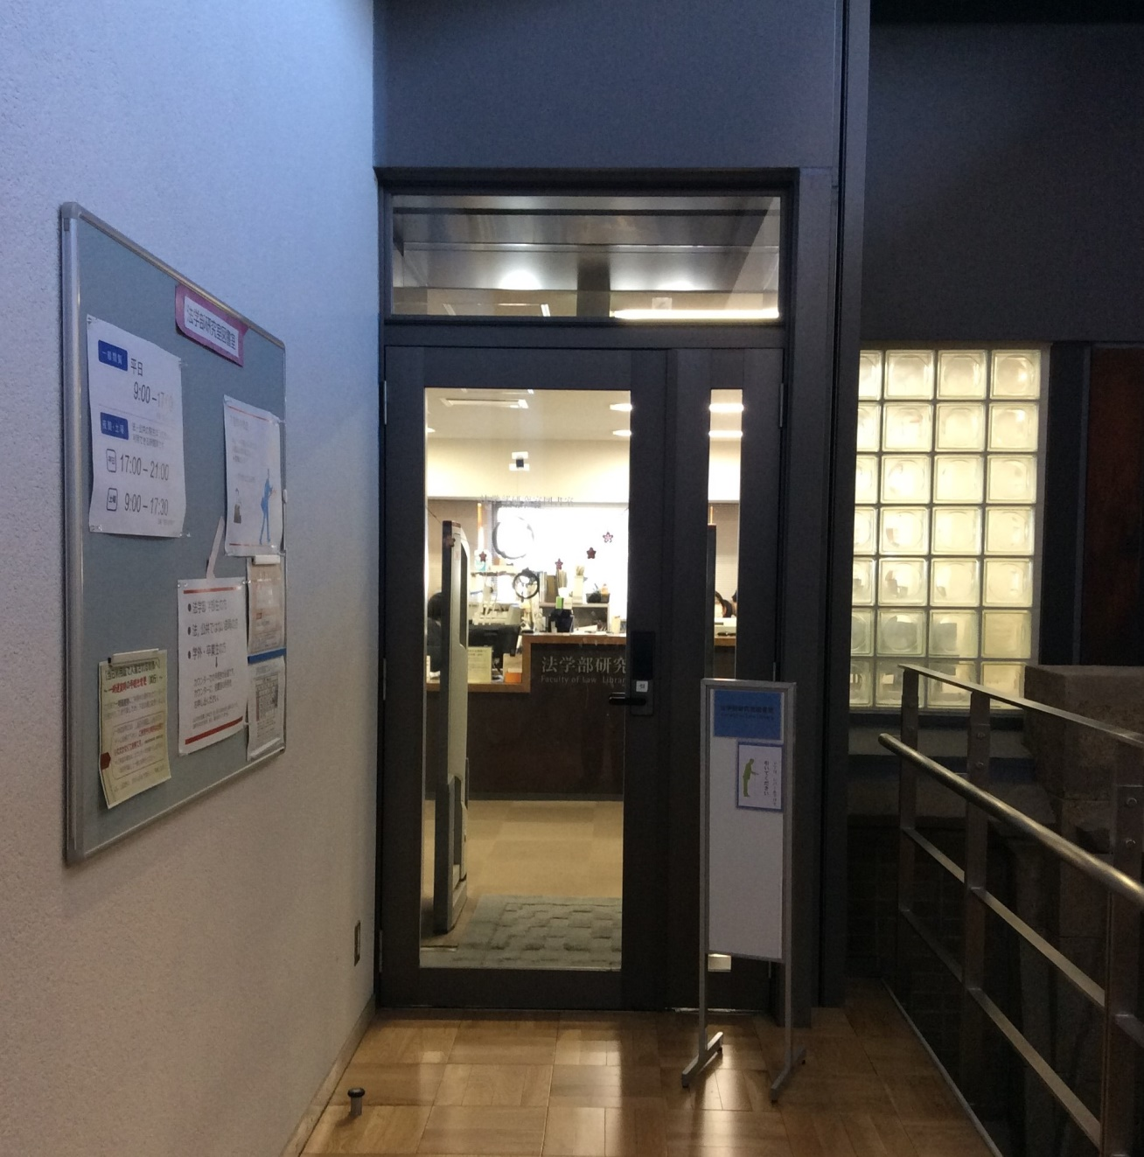
How to Use the Faculty of Law Library
2023.4

Slide 2

Faculty of Law Library
★ User Guide for GraSPP students★
No books are permitted to leave the library.
You can check some books and journals out of the library in order to use them in your study room on the day. You can keep some books on the in-library loan shelves if you use them for longer than one day.
You can enter the closed stacks by your student ID.
Interlibrary loan / photocopy service is available(*).
Reference service is available.
*Placing copy requests to UTokyo libraries and placing photocopies/book loan requests to other institutions are paid services.

Slide 3
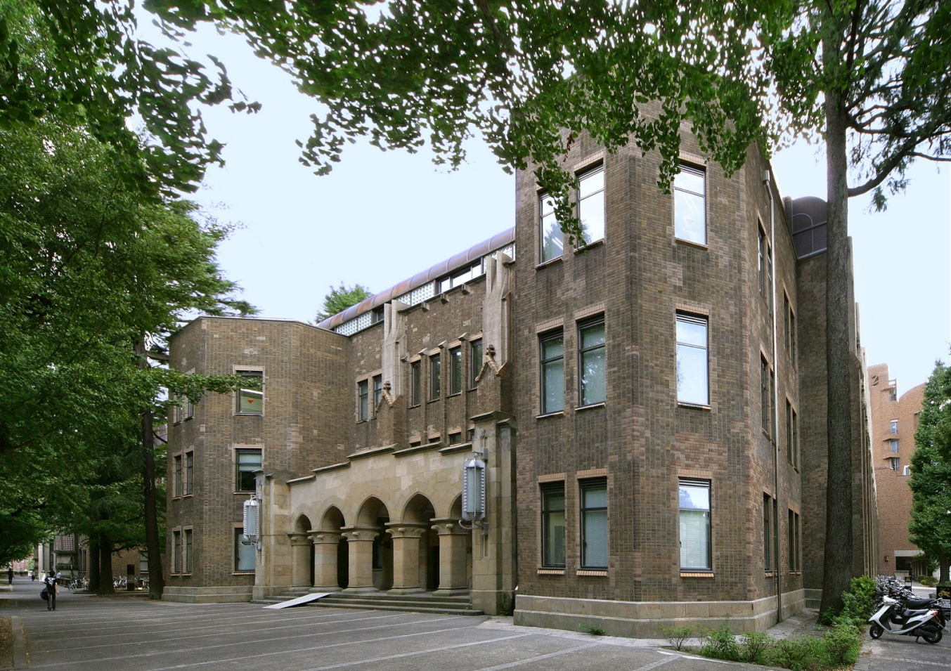
Location of the Faculty of Law Library
Law Building No.3
Yasuda Auditorium
Main Gate
Main Entrance

Slide 4
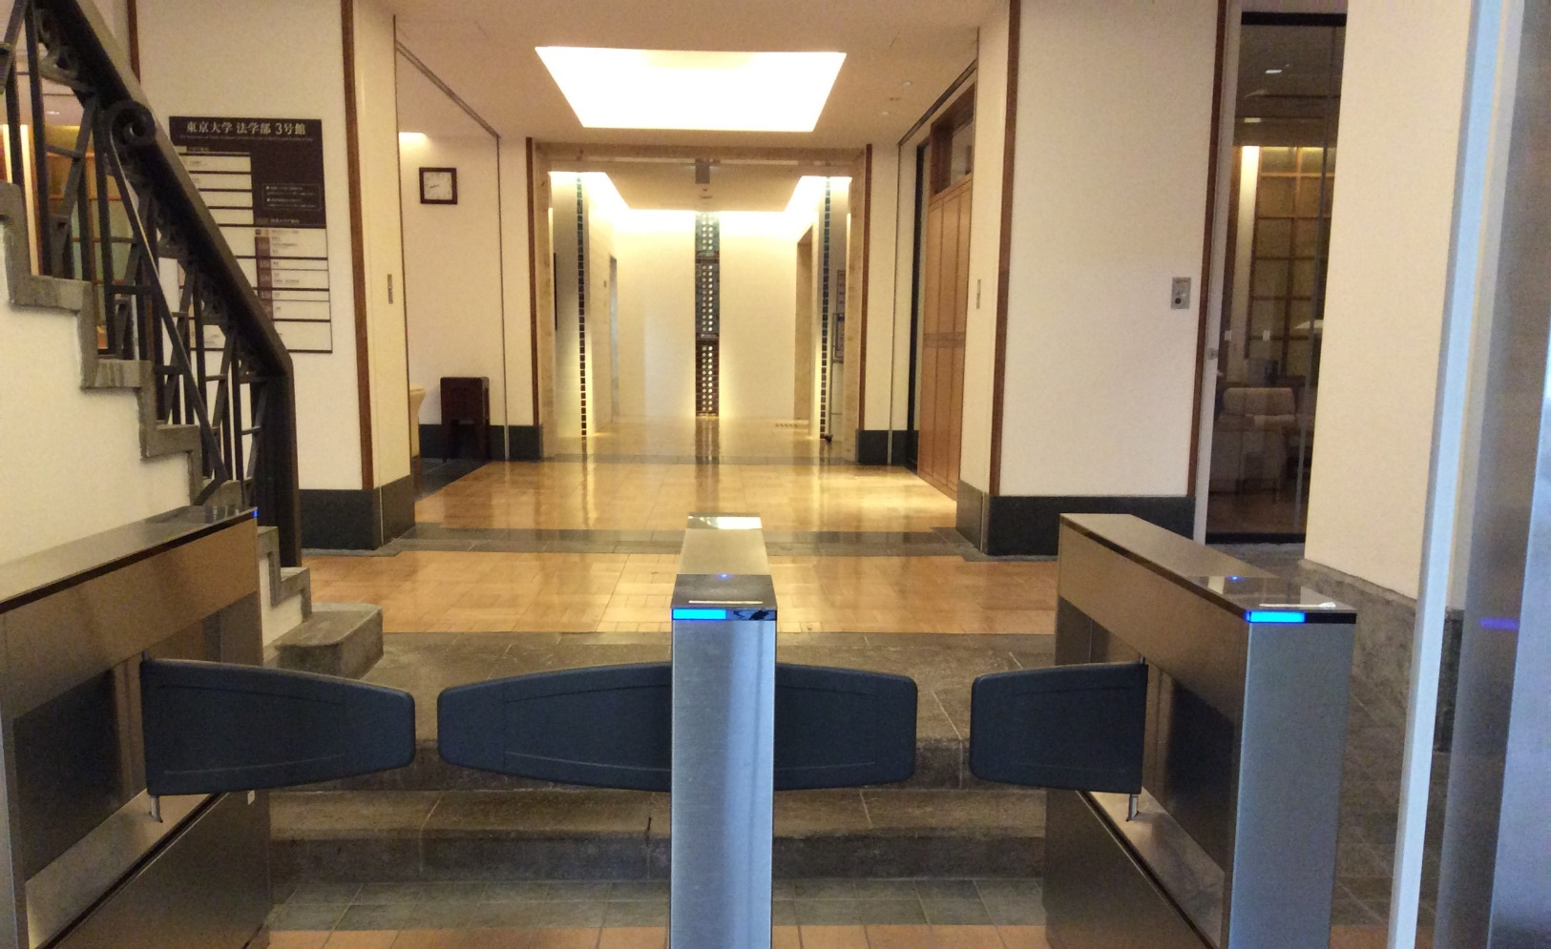

How to Enter the Library
Please take the elevator to the 4th floor.
Please hold your ID over the card reader.

Slide 5
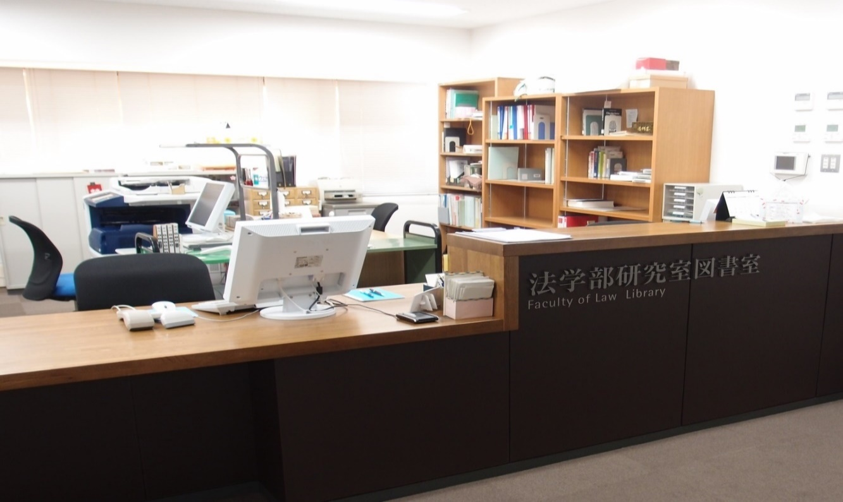

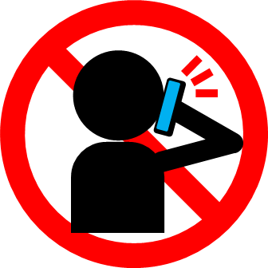
At the Service Desk
Please show your student ID at the service desk.
Library Hours Weekdays 9:00 a.m. – 9:00 p.m.
Saturday 9:00 a.m. – 5:30 p.m.
Inspection days 5:00 p.m. – 9:00 p.m.
There's a possibility that library hours may change. Please check the latest information when using the library.
The L6F of the library is located on the 4F in the Faculty of Law Bldg. No.3.
Please put your bags and other belongings in a locker.
Notes:
There are 6 floors in the library, from L1F to L6F.
The L6F of the library is located on the 4F in the Faculty of Law Bldg. No.3.
The library is open from 9:00 am to 9:00 pm on Weekdays and from 9:00 am to 5:30 pm on Saturday as of 2023.4.
There's a possibility that library hours may change. Please check the latest information when using the library.
You can receive various services at the desk. For example,
You can borrow and return books and other materials at the service desk. When you need to take out the materials temporarily, please follow the necessary procedure at the service desk.
If you borrow materials or request photocopies of literatures from other universities through MyOPAC, please pick them up at the service desk.
If you have any questions about the use of the library, please ask one of the service desk staff.

Slide 6
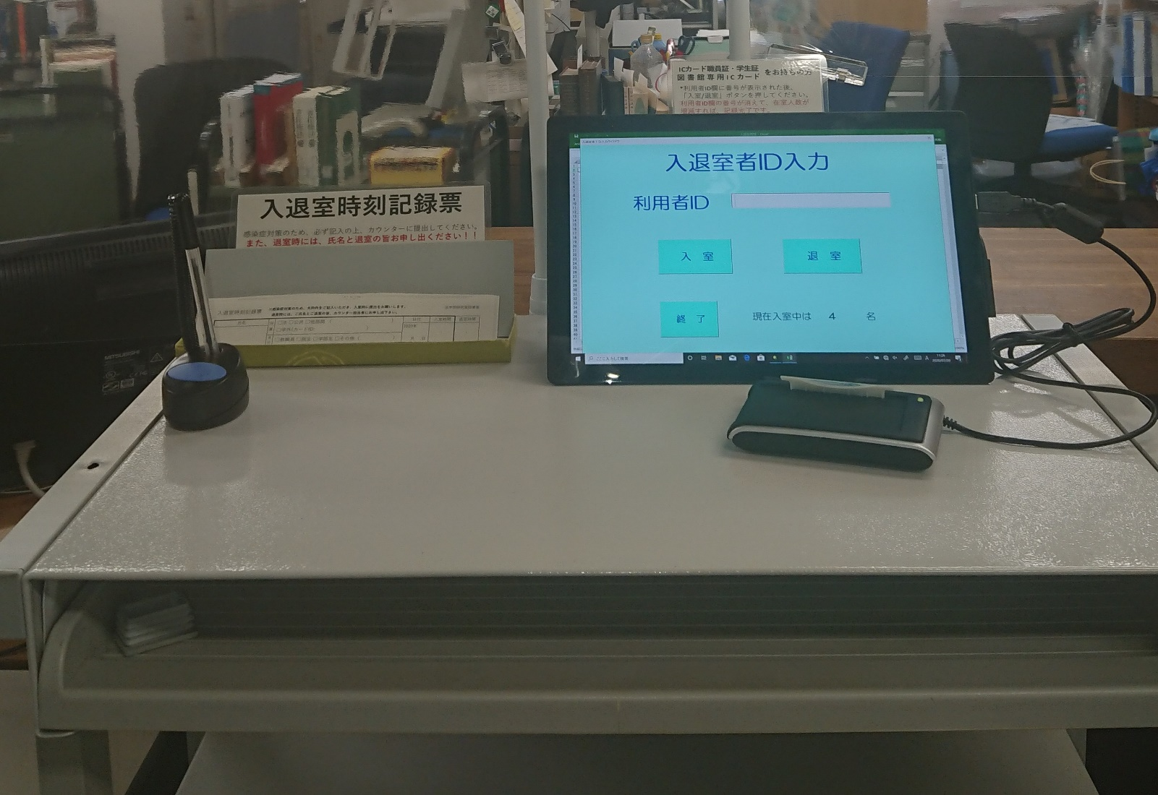
Record entering / leaving time
Please record the entering/leaving room time by the tablet when you enter and leave the library.
IC card reader
Please hold your ID over the card reader.
Notes:
Please record the entering/leaving room time by tablet when you enter and leave the library.

Slide 7
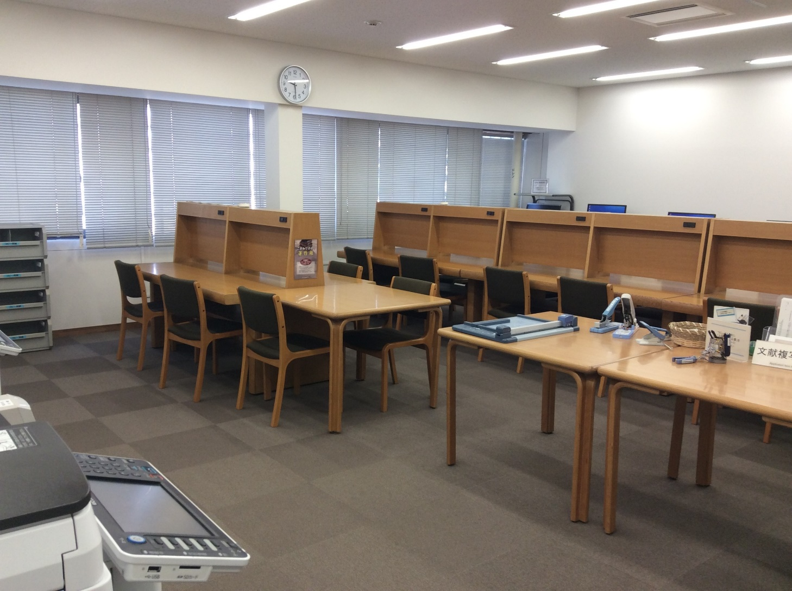
Reading Room
Please fill out the application form before making a photocopy and submit it to the service desk with the materials that you would like to photocopy.
OPAC terminals
Application form for
the photocopying
Copiers
Notes:
Here is copiers for private expense and OPAC terminals in the Reading Room.
These copiers have card-operated and coin-operated.
Please fill out the application form before making a photocopy and submit it to the service desk with the materials that you would like to photocopy.
It costs 10 yen for a black and white copy and 50 yen for a color copy.
You can use wireless LAN（UTokyo WiFi）in the library free of charge.
There are electrical outlets on the window-side desks so you can use your own PCs.
You can find OPAC terminals on each floor.

Slide 8
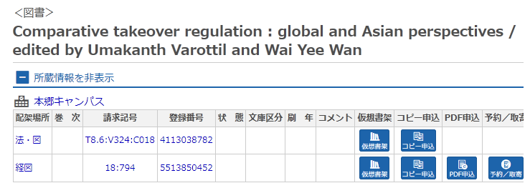


How to Find a Material from UTokyo OPAC Search Results
L6F | Periodicals in Japanese(A-Tn) Foreign law materials Books(Classifications:W0-W95, Y1-Y2) Newspaper Books for LS students
L5F | Periodicals in Japanese (To-Z) Periodicals in foreign languages (1975-)
L4F | Books(Stacks) Classifications:Q S T U Case reports/Reference materials(Classifications:W96, W98,Y3-Y9) Card catalogue
L3F | Books(Stacks) Classifications:H J P R
L2F | Books(Stacks) Classifications:D E K M N F(Official gazette) Thesis Microforms(Classifications:A)
L1F | Books(Stacks) Classifications:F G Periodicals in foreign languages(-1974) Books for GraSPP students
Law.Periodicals
4th floor
of Bldg.#3
Law.Foreign
Law.Lib
Law.LS
Law.Periodicals
【Call No. on the spine label】
T 8.6
V324
C018
Classification No.
Law.Lib
Law.Case/Ref
OPAC location | Materials
Law.Lib | Books(Classifications:W0-W95,Y1-Y2)：L6F | Open Shelves
 | Books（Except Classifications:W0-W95,Y1-Y2）：L4～L1F | Stacks
Law.Periodicals | Periodicals in Japanese：L6～L5F Periodicals in foreign languages（1975-）：L5F | Open Shelves
 | Periodicals in foreign languages（-1974）：L1F | Stacks
Law.Case/Ref | Case reports/Reference materials：L4F | Open Shelves
Law.Foreign | Foreign law materials：L6F （some materials is in the Bldg.#4,B1F） | Open Shelves (Bldg.#4,B1: stacks)
Law.LS | Books for LS students：L6F | Open Shelves
Law.Lib.B1 | Foreign law materials：Bldg.#4,B1F | Stacks
Law.Lib.B2 | Old classification books/Special collections/Old official gazettes：Bldg.#4,B2F | Stacks
Pub.Law.Lib | Books for GraSPP students：L1F | Stacks
Law.Lib
Law.Lib
Law.Lib
Law.Periodicals
Pub.Law.Lib
Bldg.#4, B1F. | Part of foreign law materials
Bldg.#4, B2F | Old classification books (Classifications:甲, 乙, I, II, III, IV ,V） Special collections Old official gazettes
Law.Lib.B1
Law.Lib
books are divided into locations according to the first alphabet of the classification no..
A | D | E | F ＊ | G | H | J | K | M | N | P | Q | R | S | T | U
L2F | L2F | L2F | L1F | L1F | L3F | L3F | L2F | L2F | L2F | L3F | L4F | L3F | L4F | L4F | L4F
Law.Lib.B2
＊Official gazette is located at L2F.

Slide 9
Links to Library Web Resources
◆Library’s Web Site
・Graduate Schools for Law and Politics / Faculty of Law Library
https://www.lib.j.u-tokyo.ac.jp/english.html
・University of Tokyo Library System： https://www.lib.u-tokyo.ac.jp/en
◆Database
・Database (Graduate Schools for Law and Politics / Faculty of Law Library) *Japanese
https://www.lib.j.u-tokyo.ac.jp/database.html
← You can search the databases on law and politics available for the University of Tokyo
members.
・ University of Tokyo Library System Database
https://www.lib.u-tokyo.ac.jp/en/library/contents/database
←You can search all the databases available for the University of Tokyo members.
◆ E-journals and E-books
・E-journal & E-book Portal
https://vs2ga4mq9g.search.serialssolutions.com/?paramdict=en-US
・UTokyo OPAC
https://opac.dl.itc.u-tokyo.ac.jp/opac/opac_search/?lang=1
★ How to use e-resources from off-campus
https://www.lib.u-tokyo.ac.jp/en/library/literacy/user-guide/campus/offcampus
★ Support for writing reports, theses and other papers
https://www.lib.u-tokyo.ac.jp/en/library/literacy/user-guide/campus/report

