Slide 1
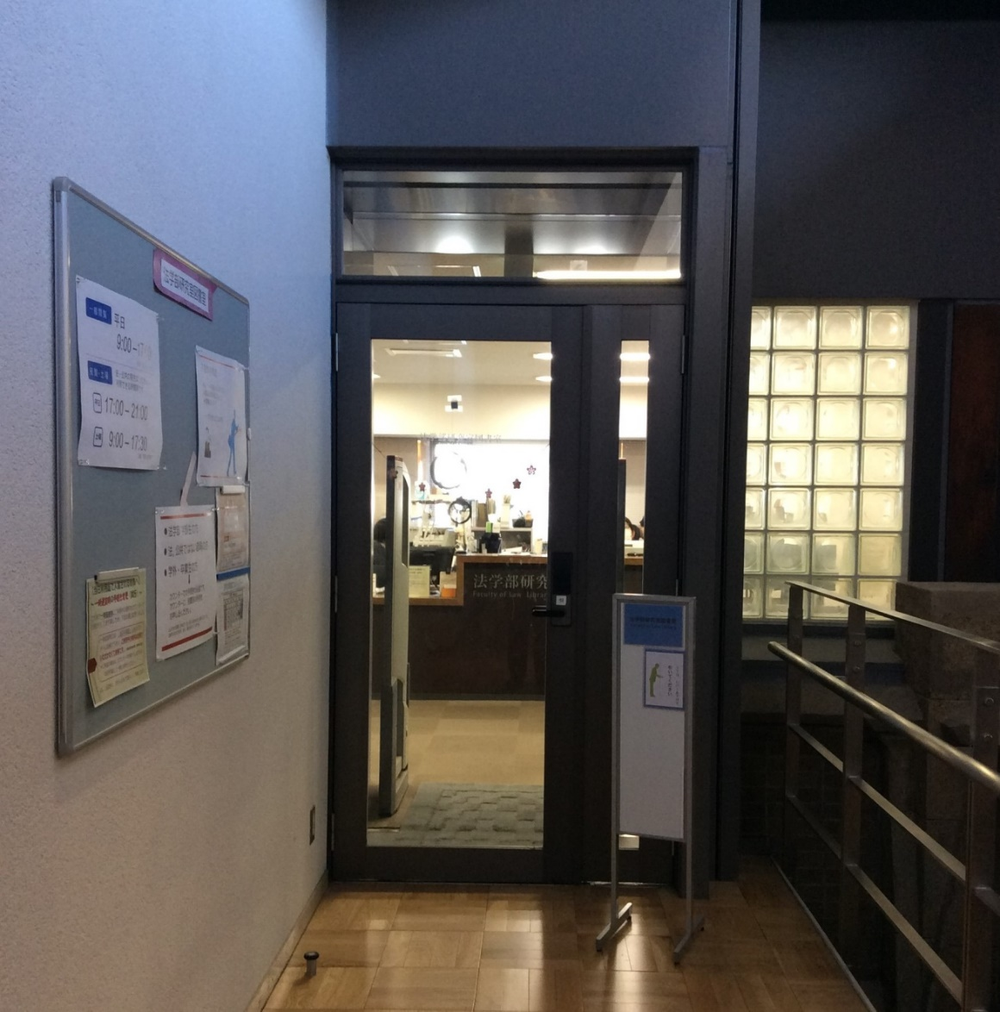
Congratulations on your enrollment!
Welcome to Faculty of Law Library
2024.4
Notes:
Congratulations to everyone on your enrollment. We will now begin our Library Tour.

Slide 2
What you can do in the our Library
Reading and photocopying of materials
Borrowing books *Cannot take books home
Students of Graduate Schools for Laws and Politics: take out to each Research Room.
LS students, GraSPP students: Bring books to the study room on the day or place them on the in-library loan shelves(stacks next to the Library service desk).
Entering stacks
Ordering books from other libraries/universities(*)
Ordering photocopies from other libraries/universities(*)
Reference service, etc.
Ordering books from other universities and ordering all photocopies are available for a fee.
Notes:
Students of Graduate Schools for Laws and Politics can read in the library, make photocopies, check out materials on the day, and bring materials to the Research Room.
LS students and GraSPP students can read in the library, make photocopies, bring materials to the study room on the day, or keep some books on the in-library loan shelves.
You can enter the stacks (closed stack area) to find books by yourself.
You can also order books and photocopies from other libraries.
In order to prevent loss of materials and to share them with more other users, materials in the Faculty of Law Library may only be taken to the Research Room/study room. Please note that materials cannot be taken home.

Slide 3
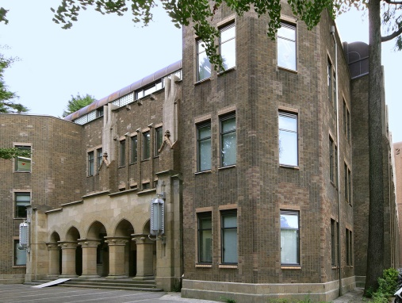
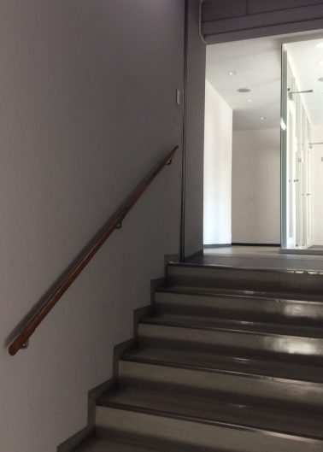
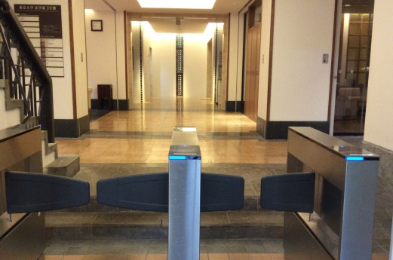
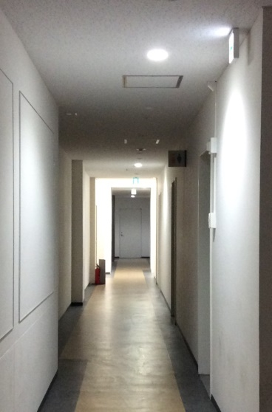
Route of Entry to the Library
From the 4th floor of Faculty of Law Bldg. No.4
Passageway to Faculty of Law Bldg. No.3
Faculty of Law Bldg. 3
Faculty of Law Building No.4
card reader
Entrance gate, Faculty of Law Bldg. No.3
Take the stairs to
the 4th floor
Corridor, Faculty of Law Bldg. No.3
At the end of the street.
To the left.
Please be quiet in the building.
Notes:
The library has an entrance on the 4th floor of the Faculty of Law Bldg. No. 3.
On weekdays from 9:00 to 17:00, you can enter from the main entrance of Faculty of Law Bldg. No. 3 and go up to the 4th floor. At night and on Saturdays, you can enter from Faculty of Law Bldg. No. 4.
To access the library from the entrance of Faculty of Law Bldg. No.4, touch your student ID card to the card reader at the entrance, and go up to the 4th floor from the stairs on the right.
On the 4th floor, there is a connecting passage to Faculty of Law Bldg. No.3. Enter Faculty of Law Bldg. No.3 and turn left at the end of the long corridor to find the entrance to the library.
Faculty of Law Bldg. No.3 and No.4 are buildings with research rooms, so please be quiet.
In addition, please stop texting while walking when doing self-tours, as it is dangerous.

Slide 4
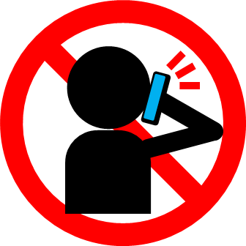
① L6 floor: Library service desk
Please bring your student ID card.
Opening Hours: weekdays 9:00 – 21:00
Saturday 9:00 – 17:30
Inventory (first or second Thursday of each month)
17:00 – 21:00
*Please check the Library Web site for the latest information.
This is the 4th floor of the Faculty of Law Bldg.No. 3., but called L6 floor in the library area.
Notes:
This is the Library service desk of the Faculty of Law Library. When entering the library, please show your student ID card and follow the entrance procedures.
The entrance to the library is located on the 4th floor of Faculty of Law Bldg. No. 3, but is referred to as the L6 floor in the library area. The library is on six levels from the L6 floor to the L1 floor.
The library is open from 9:00 to 21:00 on weekdays. On Saturdays, the library is open from 9:00 to 17:30.
Please check the Library Web site for the latest information because the library is closed once a month for inventory and the opening hours may change depending on the situation.
Eating and drinking are prohibited in the library. Please refrain from talking on cell phones.

Slide 5
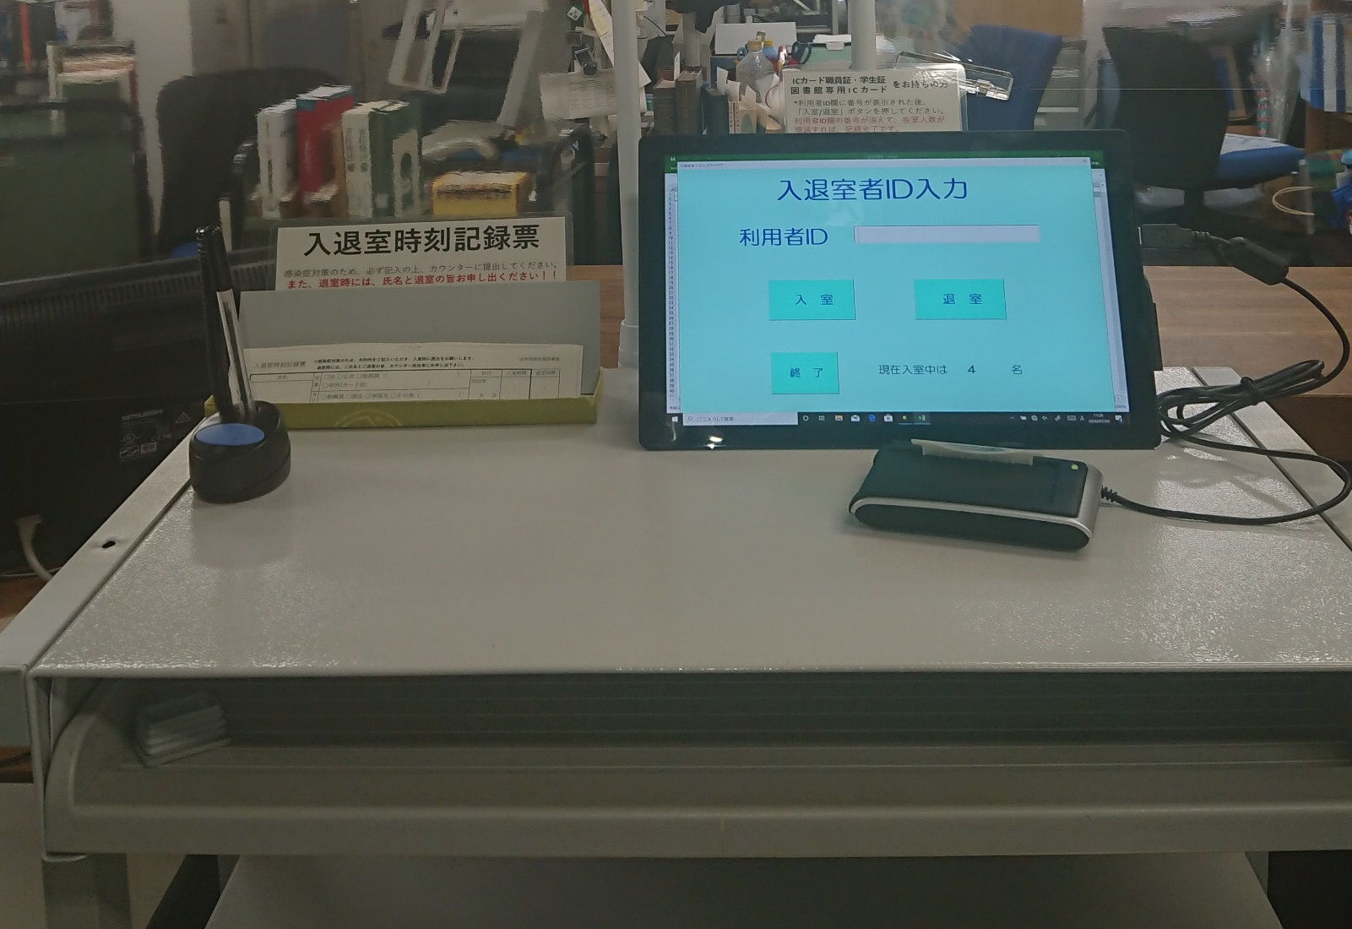
Entrance and Exit Procedures
Please use the tablet in front of the Library service desk for the entry/exit procedures.
Put your student ID card on the reader, and when the number appears in the user ID field, press the enter/exit button.
IC card reader
To the right of the Library service desk
Notes:
Please put your student ID card on the reader in front of the Library service desk and operate the tablet yourself.
When the card is placed, a 10-digit number will appear in the ID field, and tap the Enter/Exit button on the terminal.
Especially, please do not forget to follow the exit procedure.

Slide 6
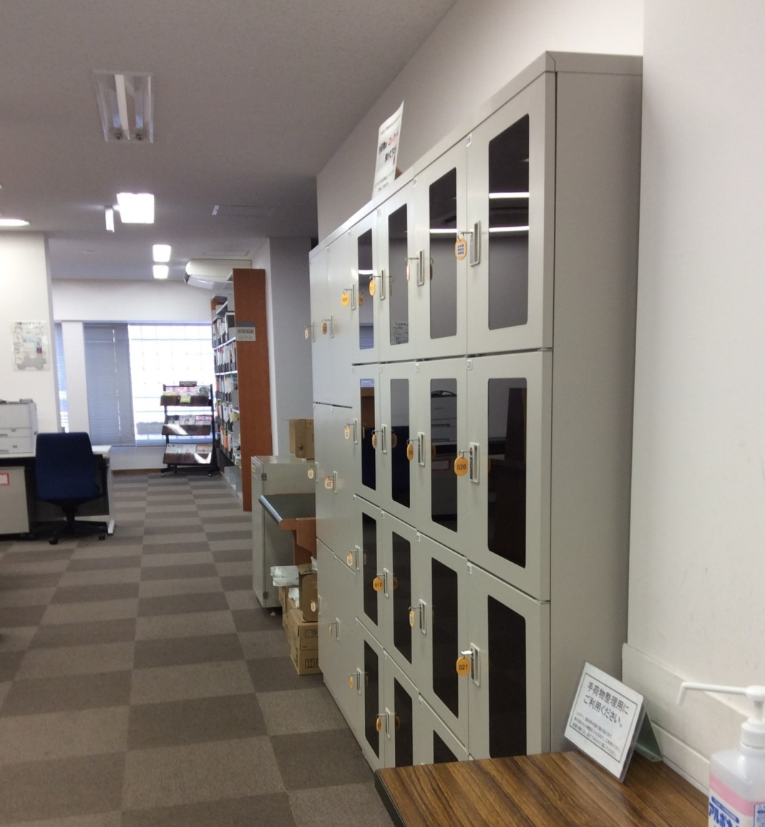
②L6 floor: Lockers for users
Please put your bag and anything unnecessary in a locker.
Reading room
Notes:
Lockers are located on the right side of the library entrance. Please put your bag and anything unnecessary in a locker.
If needed, we can supply clear plastic bags to carry your PC, books and other essential items into the library.
Please manage keys with care, as there are many cases of keys being left behind or taken home.

Slide 7
③L6 floor: Reading room
OPAC terminals
When photocopying books or journals, please fill out the Application form for the photocopying.
Application form
for the Photocopying
copy machine
Periodicals in Japanese
Notes:
There is a Reading room, a copy machine(for personal expenses) and OPAC terminals near the lockers.
Photocopy machines are available in cash and prepaid card formats.
Copy cards for public expense are not accepted here.
The extent to which books and journals may be photocopied is determined by copyright law. Before making photocopies, please fill out the Application form for the Photocopying and bring it to the Library service desk along with the materials.
Copy fee is 10 yen for monochrome and 50 yen for color. Please be careful not to forget to take your card or change.
Wireless LAN (UTokyo WiFi) is available in the library. There is an outlet above the reading table for your own PC. A desk lamp is also available for borrowing.
OPAC terminals are located on each floor.

Slide 8
④L6 floor: Periodicals in Japanese
OPAC's location display is "Law.Periodicals".
Periodicals in Japanese
(A～)
Journals are arranged alphabetically by title.
University bulletins are arranged by university name.
Books for
LS students
Corner
Newly arrived journals
(at the back of the
Reading room)
Notes:
Pass by the lockers and turn right to find a Periodicals in Japanese corner.
Journals are arranged in alphabetical order by title. However, university bulletins are arranged in order by the name of the university.
The latest issues of journals are on the Newly arrived journals shelf at the back of the Reading room.

Slide 9
⑤L6 floor: Books for LS students
OPAC display of shelving location is "Law.LS".
法科
Only LS students can take materials from this section.
To the Library service desk.
Notes:
(For LS students)
For LS students only, materials in this section can be taken out to the study room on the day.
In addition, up to 15 books can be place them on the in-library loan shelves(stacks next to the Library service desk)for two weeks for continuous use in the library.
In this section, there is an "Application Form to Purchase Books for LS students". If you have any books that you would like to have in this section, please fill out this application form and bring it to the Library service desk. You can also apply by e-mail. The Library and Academic Information Committee will review the application and decide which books to purchase.
(For Students of Graduate Schools for Laws and Politics and GraSPP students)
Books in this section can only be viewed and photocopied in the library.
The same materials may be available in the stacks, so please use them if available.

Slide 10
What we do at the Library service desk
In-library loan shelves for
LS students and GraSPP students
At the Library service desk you can borrow or layaway procedures for materials, and others.
You can place them on up to 15 materials for 2 weeks.
To the left of the Library service desk
Notes:
The Library service desk provides the following services. If you have any questions about using the library, please ask the staff at the Library service desk.
Procedures for taking out and placing materials
Guidance on how to find materials and database-related information
Receive photocopies and books from other libraries on campus that you have requested through MyOPAC
Procedures for issuing a letter of introduction when you want to visit other university libraries to look at materials in person, etc.

Slide 11
⑥L6 floor: Foreign law materials and Periodicals in Japanese (continued)
Foreign law materials
Location of OPAC is displayed as "Law.Foreign”
Periodicals in Japanese
(To “Tn”)
The OPAC's location display is
「Law.Periodicals」
Laws and judicial precedents mainly from Europe and the U.S. are laid out.
To Copy Corner
Notes:
Please turn left at the Library service desk, you will find Foreign law materials on the left side. There are mainly books of European and U.S. laws and precedents. Please use them inside the library.
On the right side and at the end of the aisle are Periodicals in Japanese titles from the middle of “K” to “Tn.”

Slide 12
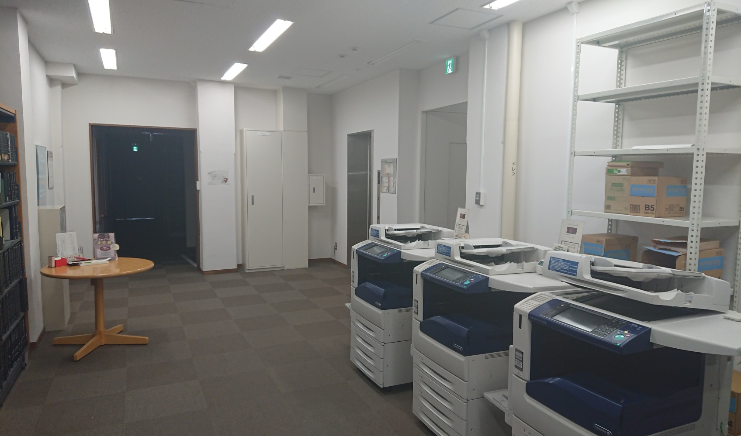
⑦L6 floor: Copier for public expense
When photocopying books or journals, please fill out the Application form for the Photocopying
To L5 floor
Application form
for the
Photocopying
One Copy machine for public expense, which
accepts a copy card, is also located on the L5 floor.
Notes:
(For Students of Graduate Schools for Laws and Politics)
There is a Copier for public expense that accepts copy cards distributed by the Laboratory Administration Team.
The extent to which books and journals may be photocopied is determined by copyright law. Before making photocopies, please fill out the Application form for the Photocopying and bring it to the Library service desk along with the materials.
When you have used up your Copier for public expense card, please use the Copier for private expense.
Please do not forget to take your card.

Slide 13
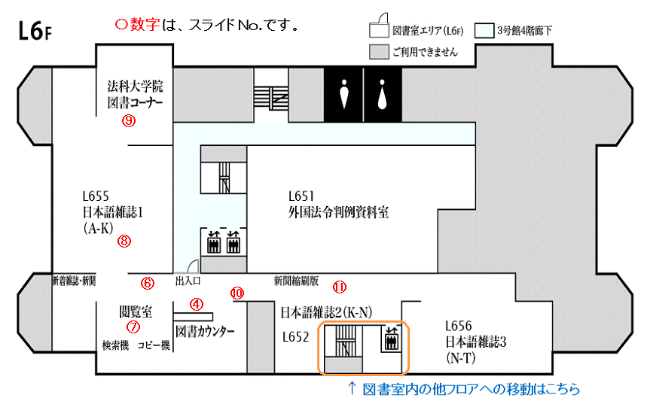
L6 Floor Map
Library Area
(L6)
Hallway on the 4th floor of Bldg. 3
Unavailable
Books
for LS students
Round numbers correspond to the numbers in the slide headings
⑤
L655
Periodicals in Japanese 1
(A-K)
L651
Foreign law materials
④
⑥
②
doorway
Pocket newspapers
③
①
⑦
Reading room
Periodicals in Japanese2
L656
Periodicals in Japanese 3
(N-T)
Library service desk
(K-N)
L652
OPAC
copier
Newly arrived journals, newspapers
Please take the stairs or elevator to move to other floors in the library.
Notes:
This is the floor map of the L6 floor we have shown you so far.
The lower floor of the library is accessible by the stairs or elevator inside the library.

Slide 14
L5 floor
Periodicals in Foreign Languages (since 1975)
The OPAC's location display is
「Law.Periodicals」
Periodicals in Japanese
(“To” and after)
The OPAC's location display is
「Law.Periodicals」
Periodicals in Foreign Languages before 1974 are located in the stacks on the L1 floor.
To L4 floor
Notes:
Periodicals in Japanese titles from “To” and Periodicals in Foreign Languages since 1975 are arranged alphabetically by title on the L5 floor.
Periodicals in Foreign Languages before 1974 are located in the stacks on the L1 floor.

Slide 15
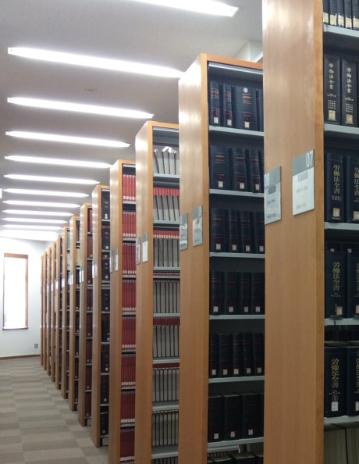
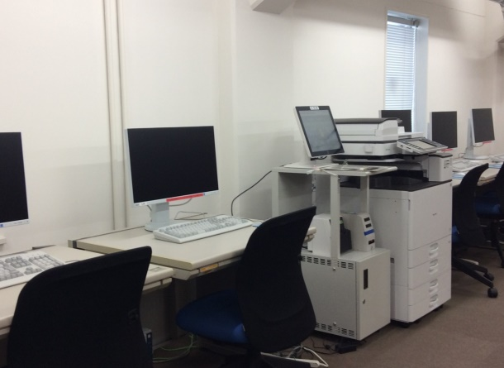
L4 floor
courtroom
reference library
The OPAC location display is Law.Case/Ref
Shared terminal
To L4floor stacks
Japanese case law and reference books are available.
Notes:
Case Reports / Reference Materials Room is located on the right side of the L4 floor. In the Case Reports / Reference Materials Room, there are Japanese precedents and reference books. There is a prepaid card copy machine (for private expense) at the end of the room.
There are shared-use terminals and a printer and the Card catalogue on the leftside of the L4 floor.
You can log in to search databases in the same way as the terminals in the study room and the common workroom.
You can pay for the printer with prepaid cards, SUICA, and PASMO.
Please be sure to follow the on-screen instructions for removing the prepaid card or IC card. Pulling out the card by hand may cause an error.

Slide 16
L4 floor: stacks entrance
<OUT>
Turn the thumbturn.
Please open the door.
<IN>
Please place your student ID card to the card reader.
card reader
thumbturn
Into the stacks.
Notes:
Closed stacks are located on the L4 to L1 floors. The stacks are locked, so when entering the stacks, please place your student ID card on the card reader to unlock the stacks.
When exiting stacks, turn the thumbturn before opening the door.

Slide 17
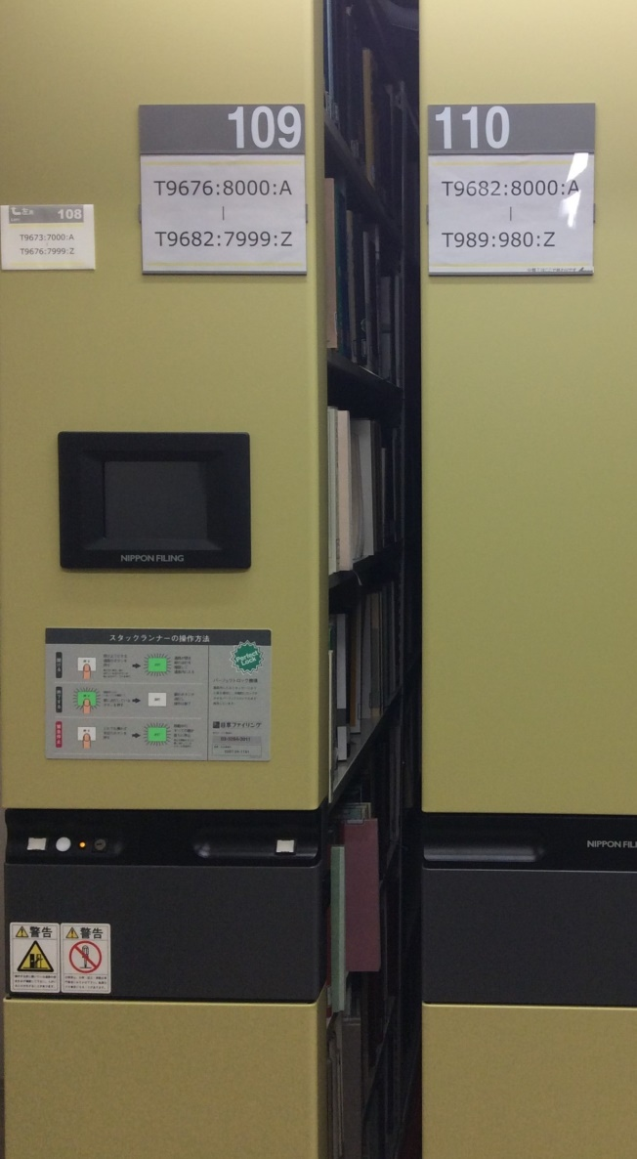
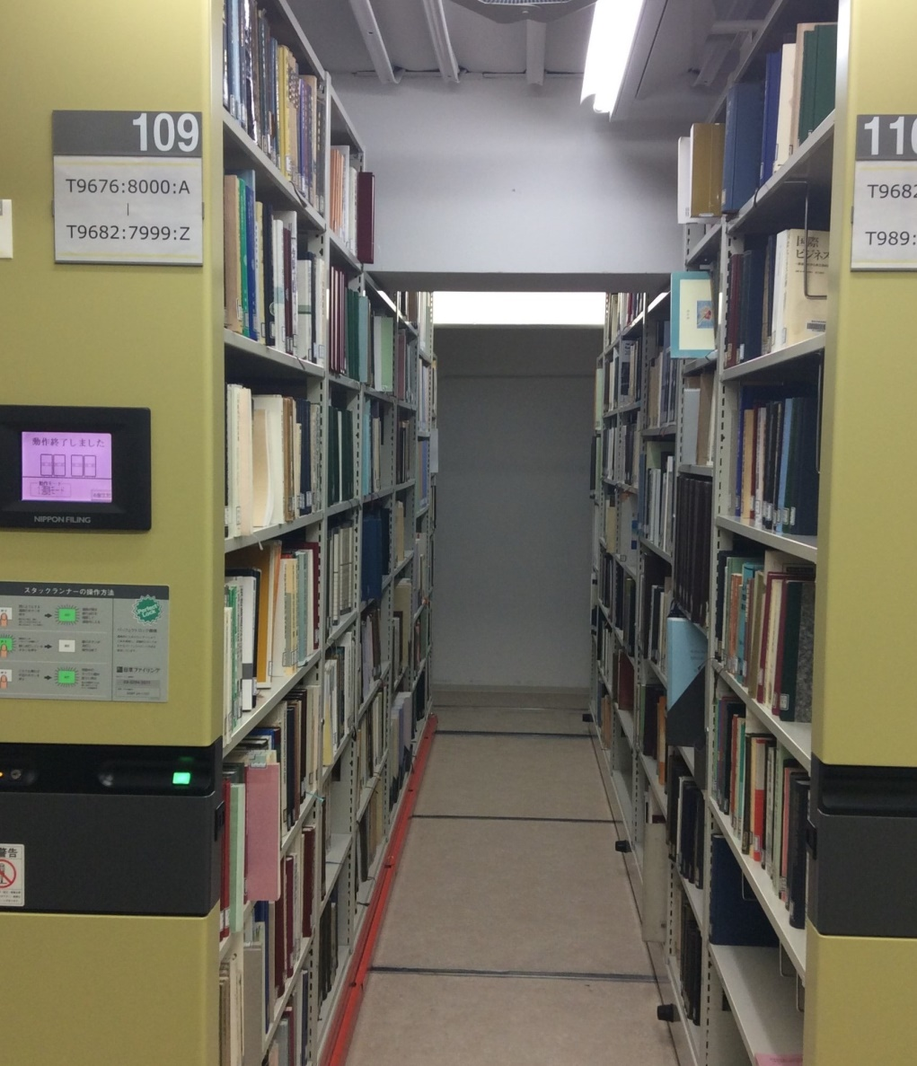
How to use motorized stacks
OPAC location of stacks is displayed as "Law.Lib.”
The call no. of the book is indicated on each shelf.
call no. indication
Stacks open/close button
Glows green when pressed.
To L1 floor stacks
Press the orange bar with your foot. The moving bookshelf will stop.
Notes:
The books are located in the closing stacks.
The call no. of the book is indicated on each shelf, so please open the shelf where the book you want to use and take it out.
(For LS students and GraSPP students)
Materials in the stacks can also be taken out to the study rooms on the day.
If you wish to use a book continuously in the Library, you can place them on the in-library loan shelves(stacks next to the Library service desk)up to 15 books for two weeks.

Slide 18
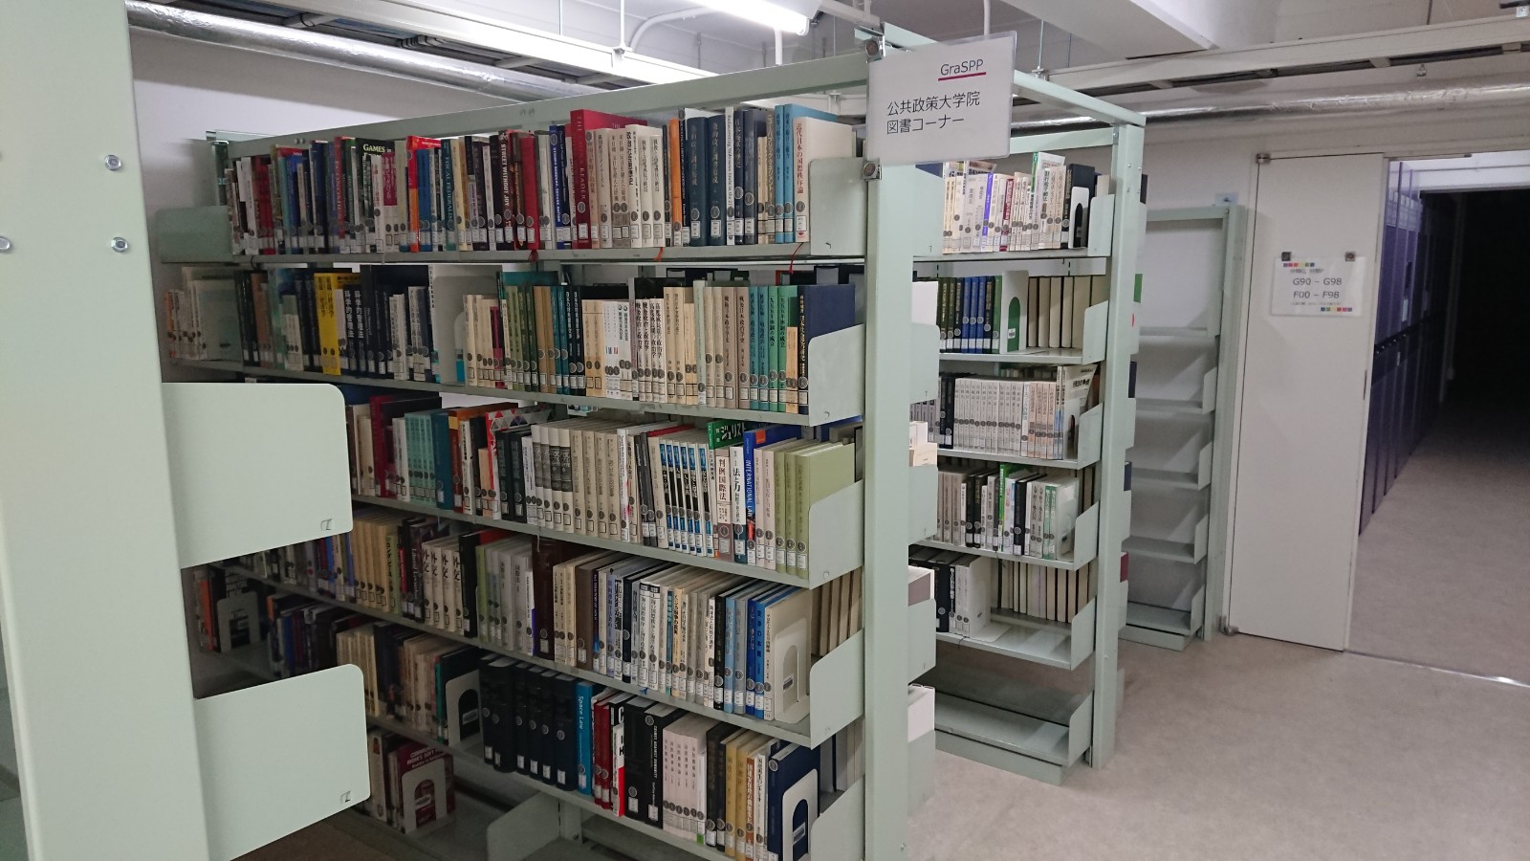
L1 floor: GraSPP students book corner
OPAC's location display is “Pub.Law.Lib”
Only GraSPP students can take materials from this section.
book post
18
Notes:
The GraSPP students Library Corner is located on the leftside of the entrance of the L1 stacks.
(For GraSPP students)
Only GraSPP students can take materials from this section to their study rooms on the day.
If you wish to use a book continuously in the Library, you can place them on the in-library loan shelves(stacks next to the Library service desk)up to 15 books for two weeks.
(For Students of Graduate Schools for Law and Politics and LS students)
Books in this section may only be viewed and photocopied.

Slide 19
Book Post
The Book Post is located across from the lounge on the first floor of the Faculty of Law Building No. 3.
Do not put in deteriorated materials or materials from other universities.
How to view OPAC
Notes:
Book post is located across from the lounge on the first floor of the Faculty of Law Building No. 3.
Please use the packing materials and rubber bands you can return books to this post prevent damage to the materials.
Please return to the Library service desk any materials that were indicated as “do not put in the book post” (deteriorated materials) or materials from other universities.

Slide 20
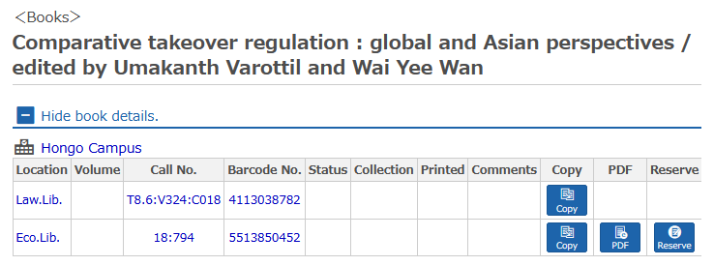
How to Find a Material from UTokyo OPAC
【Call No. on the spine label】
T 8.6
V324
C018
Check the Location and
Call no.!
Classification No.
OPAC location | Materials
Law.Lib | Books(Classifications:W0-W95,Y1-Y2)：L6F | Open Shelves
 | Books（Except Classifications:W0-W95,Y1-Y2）：L4～L1F | Stacks
Law.Periodicals | Periodicals in Japanese：L6～L5F Periodicals in foreign languages（1975-）：L5F | Open Shelves
 | Periodicals in foreign languages（-1974）：L1F | Stacks
Law.Case/Ref | Case reports/Reference materials：L4F | Open Shelves
Law.Foreign | Foreign law materials：L6F （some materials is in the Bldg.#4,B1F） | Open Shelves (Bldg.#4,B1: stacks)
Law.LS | Books for LS students：L6F | Open Shelves
Law.Lib.B1 | Foreign law materials：Bldg.#4,B1F | Stacks
Law.Lib.B2 | Old classification books/Special collections/Old official gazettes：Bldg.#4,B2F | Stacks
Pub.Law.Lib | Books for GraSPP students：L1F | Stacks
Law.Lib
books are divided into locations according to the first alphabet of the classification no..
A | D | E | F ＊ | G | H | J | K | M | N | P | Q | R | S | T | U
L2F | L2F | L2F | L1F | L1F | L3F | L3F | L2F | L2F | L2F | L3F | L4F | L3F | L4F | L4F | L4F
＊Official gazette is located at L2F.
Notes:
You can search for materials held at the University of Tokyo Libraries through the UTokyo OPAC.
As shown in this tour, you can find the material by checking the "Location" and "Call No." (Classification No.).
If you cannot find the book, please ask at the Library service desk
That concludes the library tour. Thank you very much.

